Slide 1



Water Jug Problem
in Artificial IntelligencE

Slide 2
Introduction
Welcome to the exploration of the Water Jug Problem, a classic puzzle in Artificial Intelligence that showcases problem-solving techniques.

Slide 3
Problem Description
The Water Jug Problem involves two jugs, a 4-liter and a 3-liter one, a pump, and the goal of measuring exactly 2 liters in the 4-liter jug. This problem is an excellent example to illustrate the four components of formal problem definition: Initial State, Successor Function, Goal Test, and Path Cost.
The state representation is a tuple (x, y) where x is the water in the 4-liter jug, and y is the water in the 3-liter jug. The initial state is (0, 0), and the goal state is (2, 0)

Slide 4
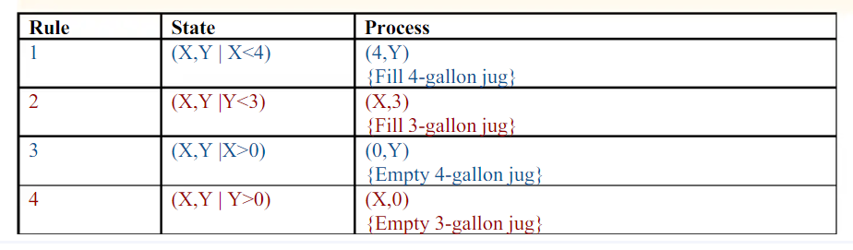
Successor Function and Rules

Slide 5
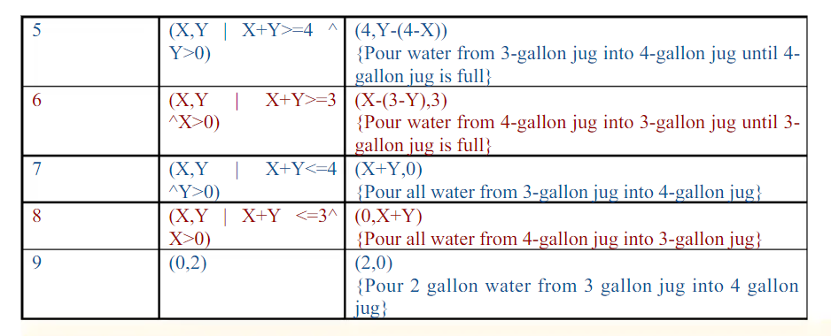
Successor Function and Rules

Slide 6
Problem Solving Steps
Step-1: Initialization:
Start State: (0,0)
Apply Rule 2: Fill 3-gallon jug Now the state is (x,3)
Step 2:
Current State: (x,3)
Apply Rule 7: Pour all water from 3-gallon jug into 4-gallon jug
Now the state is (3,0)
Step 3:
Current State : (3,0)
Apply Rule 2: Fill 3-gallon jug Now the state is (3,3)

Slide 7
Problem Solving Steps
Step 4:
Current State: (3,3)
Apply Rule 5: Pour water from 3-gallon jug into 4-gallon jug until 4- gallon jug is full
Now the state is (4,2)
Step 5:
Current State : (4,2)
Apply Rule 3: Empty 4-gallon jug Now state is (0,2)
Step 6:
Current State : (0,2)
Apply Rule 9: Pour 2 gallon water from 3 gallon jug into 4 gallon jug Now state is (2,0)
Step 7:
Now the state is (2,0)-- Goal Achieved.

Slide 8



THANKS

